Slide 1
Observer Pattern
Behavioral Design Pattern

Slide 2
GoF Patterns
Creational Patterns (5)
Deals with initializing and configuring classes and objects
Structural Patterns (7)
Deals with decoupling interface and implementation of classes and objects
Behavioral Patterns (11)
Deals with dynamic interactions among societies of classes and objects (i.e. how they distribute responsibilities)
* The observer pattern is behavioral design pattern.

Slide 3
Simplified Design Principles
Strive for loosely coupled designs between objects that interact.
Loosely coupled designs allow us to build flexible systems that can change over time since there is little interdependency between objects.

Slide 4
I need to know!
One of the most common requirements in a complex system is the ability of an object to know whenever an event happens or if the state of another object changes.
Stock price changed
Button clicked
Page closed

Slide 5
I need to know!
There are two methods commonly used to solve this problem.
Polling – This is the approach you likely took in 221. If an object needed to know, it would periodically call to get the information. How well would this work with a GUI application?
Notification – Objects register to receive a notification whenever state changes or an event occurs.

Slide 6
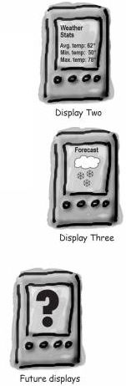
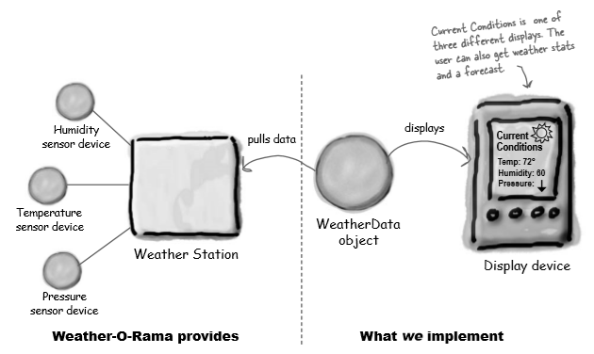
Problem Statement
Multiple displays need to be updated with weather data from a single weather station.
©Head First Design Patterns, Freeman and Freeman

Slide 7
Problem Statement
What we know
The weather station does it’s thing to collect data. We don’t need to know or care how it does it.
When any of the data changes, the weather station is going to call the measurmentsChanged method on the WeatherData object
Again, we don’t need to know how
Our job is to implement measurementsChanged to update the 3 displays
We also have to keep future grown in mind

Slide 8
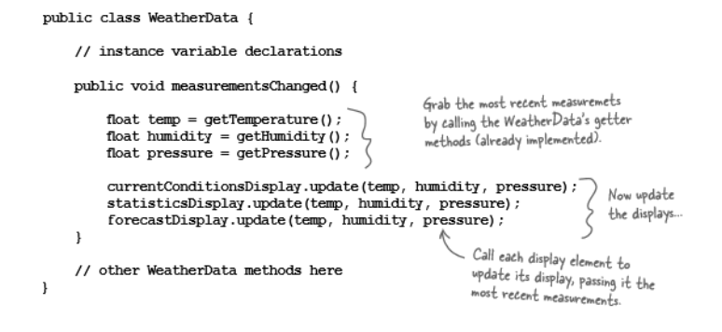
A First Attempt
©Head First Design Patterns, Freeman and Freeman

Slide 9
Simplified Design Principles
Let’s not forget our simplified designed principles. Does this design:
Identify things that may change and separate them from what stays the same?
Code to a contract/interface and not to an implementation?
Have loosely coupled objects?

Slide 10
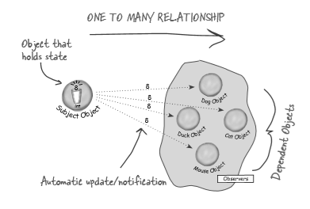
Publisher - Subscriber
Have you ever subscribed to a service? For example, if I subscribe to a podcast, when the publisher creates new content it is pushed to all of its subscribers, including me! I also have the ability to unsubscribe if I did not like the content after all.

Slide 11
Observer Pattern
Defines a one – to – many dependency between objects so that when one object changes state, all of its dependents are notified and updated automatically.
Objects can decide if they want to be notified. They can even make that decision at runtime!
Also know as the Publisher-Subscriber pattern.
Allows for consistent data across objects without tight coupling

Slide 12
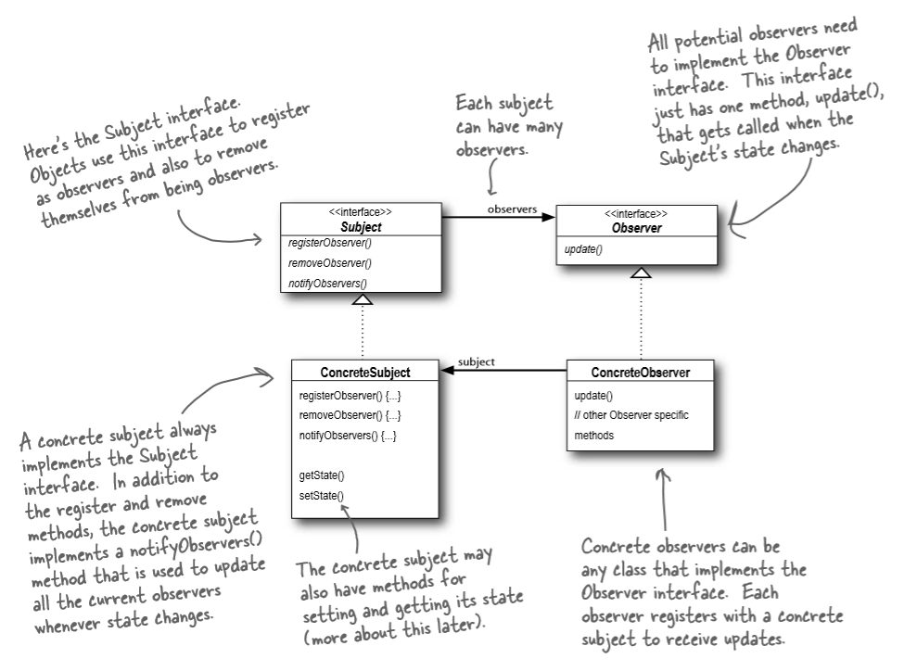
Observer Pattern
©Head First Design Patterns, Freeman and Freeman

Slide 13
Breaking Down The Pattern
Subject Interface
Needs to know its observers. It provides an interface for attaching and detaching subjects
Observer Interface
Provides an interface to notify the subjects of changes
Concrete Subject
Implements subject interface to allow for subscribing and detaching.
Sends notifications to observers when changes occur
Concrete Observer
Implements the observer interface to receive updates

Slide 14
Loosely Coupled
Loosely coupled objects can interact, but have very little knowledge of each other
In the observer pattern:
The only thing the subject knows about the observer is that it implements the observer interface
We can add or remove observers at any time
We can extend to add new concrete class types without modifying the subject
We can reuse subjects or observers independently of each other
We can change either the subject or the observer without affecting the other

Slide 15
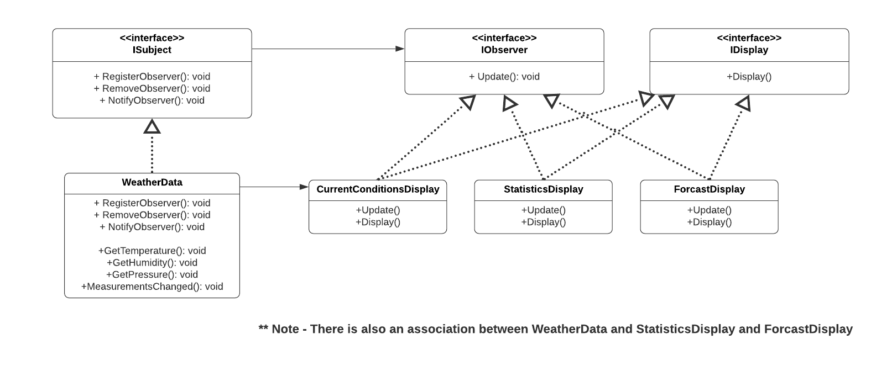
Weather Station Solution

Slide 16
Potential Drawbacks
Random order observers are updated
Repeated updates when there is a series of incremental changes

Slide 17
Let’s Write Some Code!

